Slide 1
Graph Analytics Final Project​ ​ Qiuyuan Zhang​ Shreyashi Mukhopadhyay Xiaohong Liu November 30, 2023

Slide 2

Amazon Co-purchasing Network Analysis

Slide 3

Contents:
Data Pre-processing & Exploratory analysis
Results and Evaluation
Problem Statement and Objective
Algorithms, Analysis, and Implementations
Conclusions
Group Member Contributions
Notes:
Charanya

Slide 4
Problem Statement and Objective

Slide 5
Problem Statement and Objective
Objective
Leveraging Amazon product co-purchasing network dataset from Stanford Network Analysis Project, which involves more than 500,000 different products, including books, music CDs, DVDs to formulate and visualize the products as a graph then use this graph to find products similar to a given product.
Problem Statement
How does the product recommendation system work in online shopping, and how can we effectively utilize Amazon's product information to build a recommendation model that caters to various types of users?

Slide 6
Data Source

Slide 7

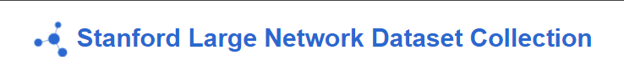

Data Source
https://snap.stanford.edu/data/amazon0302.html
https://snap.stanford.edu/data/amazon-meta.html

Slide 8
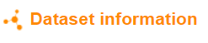
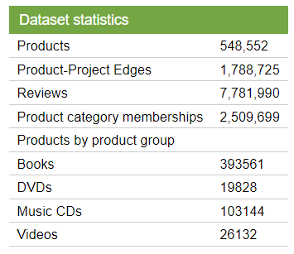
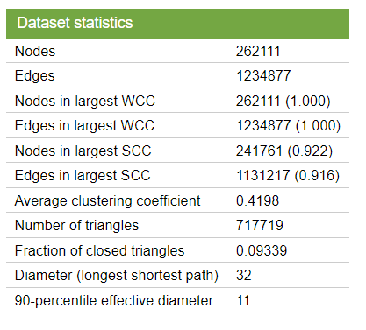

Slide 9
EDA

Slide 10
Data Overview
Dataset | Date | Brief Description
Amazon product co-purchasing network, March 02 2003 | Collected from March 02 2003 | Includes product co-purchasing network information with 262111 nodes and 1234877 edges.
Amazon product co-purchasing network metadata | From summer 2006 | Includes various types of relevant product information such as Title, Sales rank, and List of similar products.

Slide 11
Amazon Metadata Network EDA

Slide 12
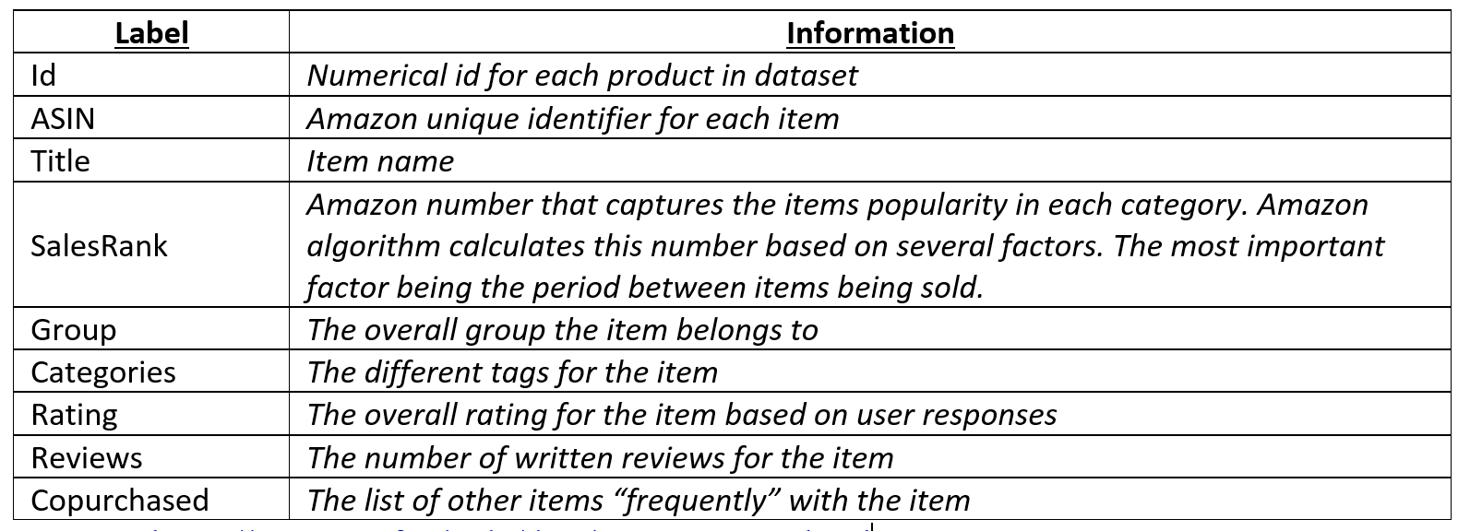
Amazon Metadata Description
Stanford SNAP database
Product metadata for Books, Music, CDs, DVDs and VHS Tapes and other categories.
548,552 products represented in the file
Text file containing information from summer 2006

Slide 13
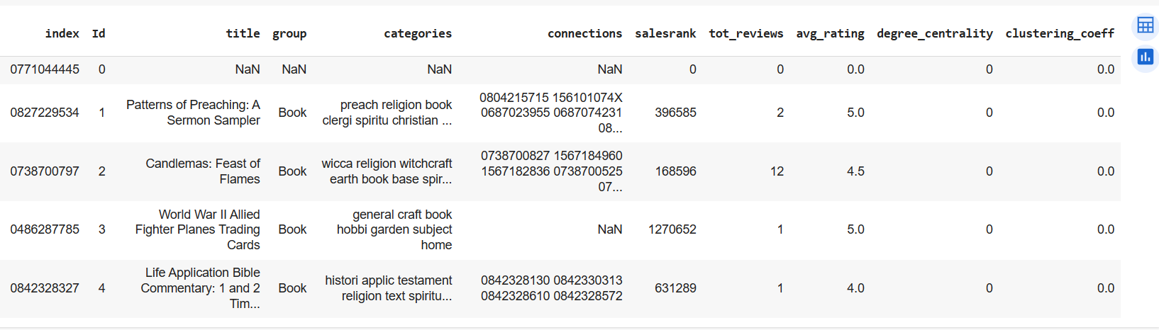
Data description
NODES: are the ASINs (index)
EDGES: exist between two Nodes if the two ASINs were co-purchased
EDGE WEIGHT: it is based on category similarity
SIMILARITY (Connections): A measure between any two ASINs that were co-purchased and it can be calculated as the number of words that are common between categories of connected Nodes divided by the total number of words in both categories of connected nodes. The similarity range goes from 0 (most dissimilar) to 1 (most similar).

Slide 14
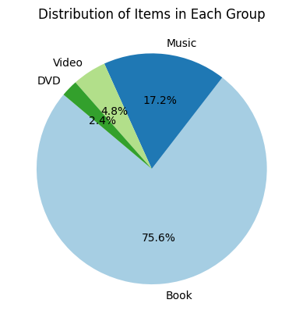
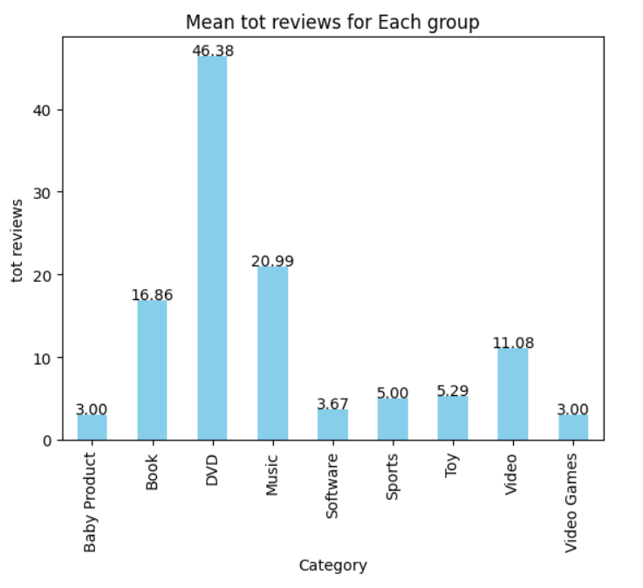
Amazon Metadata Exploration
There are total 345572 rows in Amazon Metadata.
Book products make up the majority of the entire dataset, but higher average reviews for DVD.
Book products have the lowest ratings compared to music, videos, and DVDs. This may affect the confidence of recommendations among books.
Book products still maintain the highest sales rank indicates that this category of products continues to have a high probability of recommendation.

Slide 15
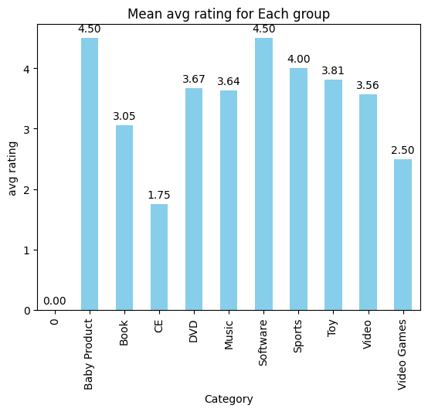
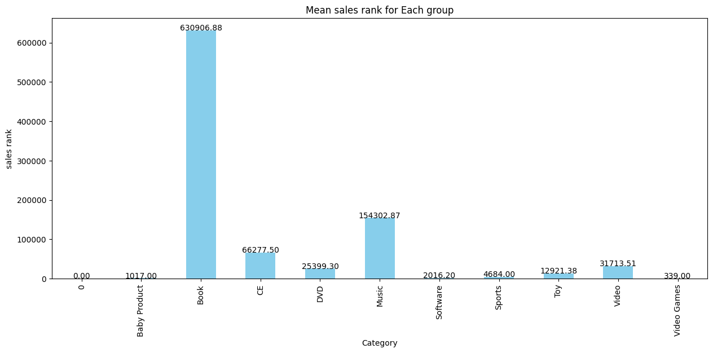
Amazon Metadata Exploration
Book products still maintain the highest sales rank indicates that this category of products continues to have a high probability of recommendation.

Slide 16
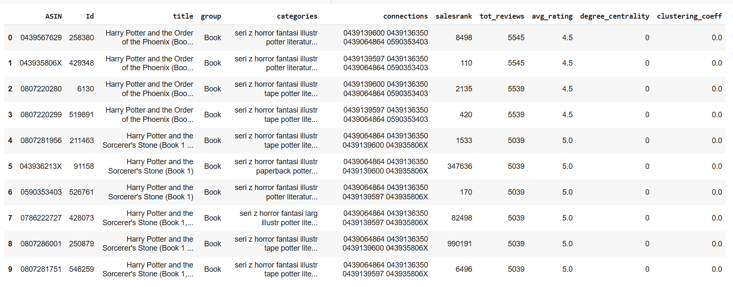
Amazon Metadata Products with Highest reviews
The Harry Potter Books within the Books group have the highest total reviews and average rating and have a high number of connections with each other.

Slide 17
Amazon 0302 Network EDA

Slide 18
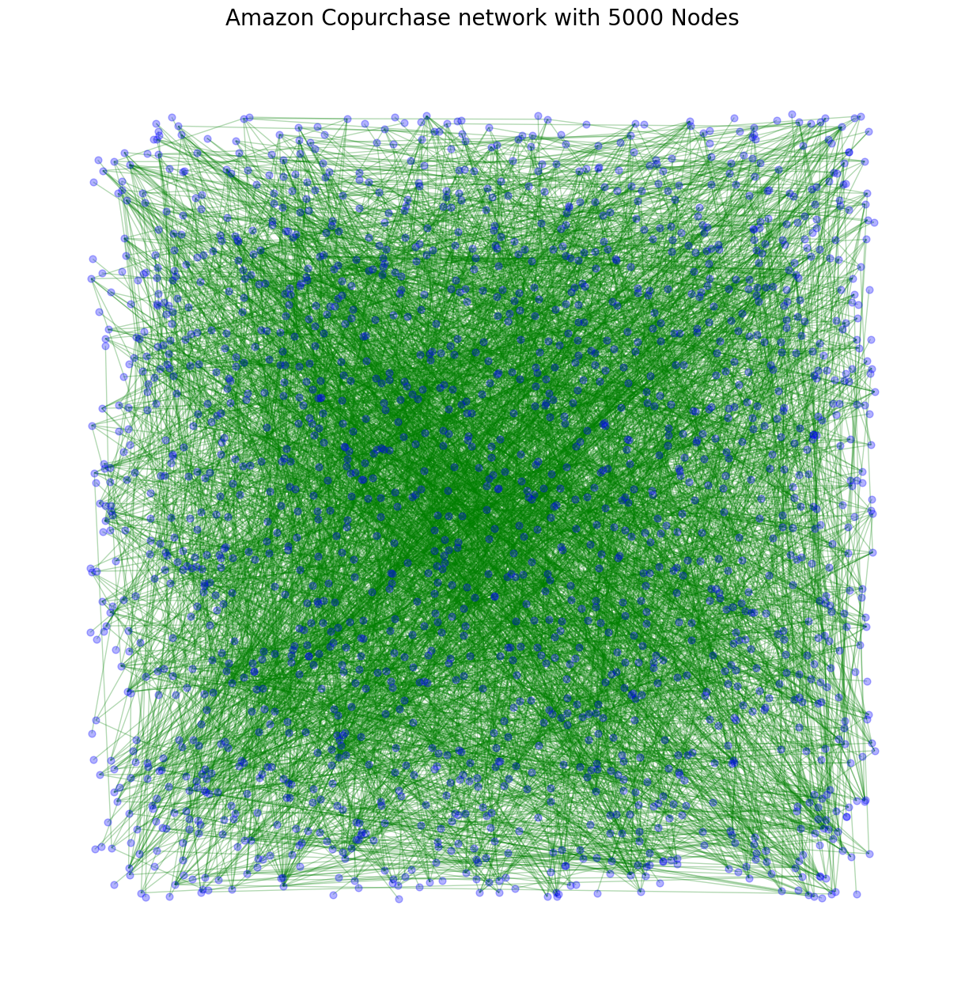
Network Visualization
Check whether the Graph is directed: False
The Number of Nodes in the Network: 1761
The Number of Edges in the Network are: 3894
The radius of the network is: 8
The diameter of the network is: 15
The density of the network is: 0.0025127768313458264

Slide 19
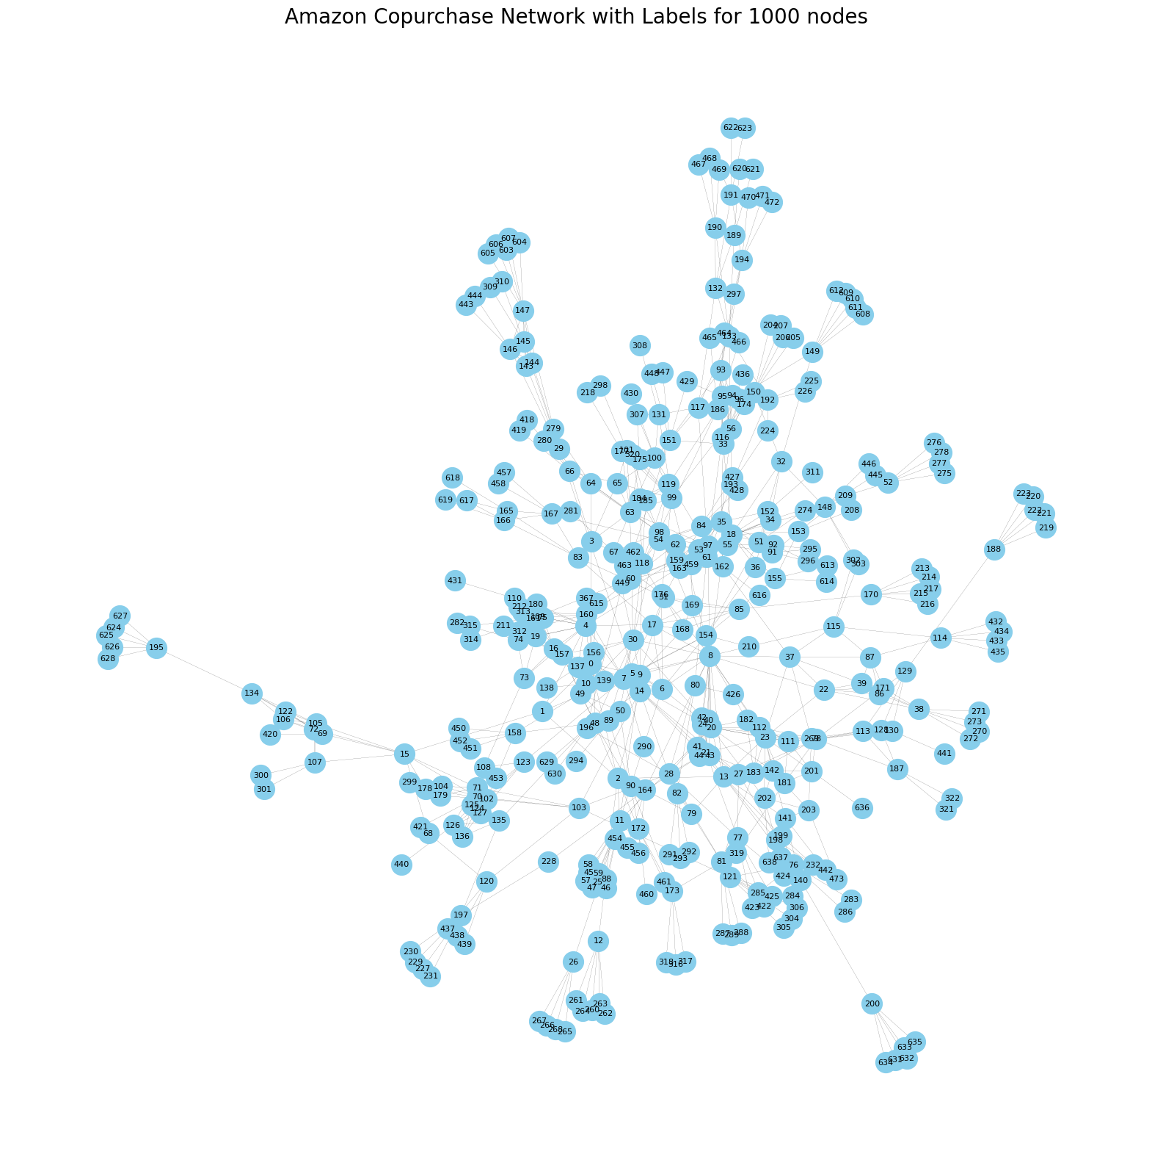
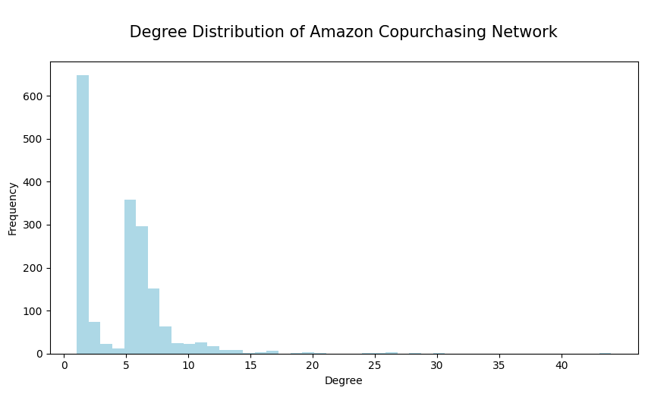
Network Visualization with labels & degree distribution

Slide 20
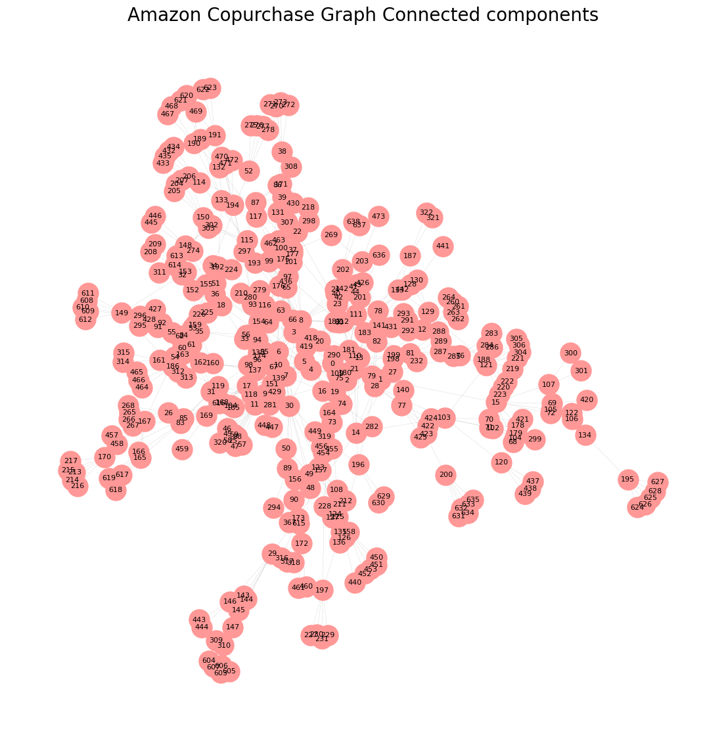
Network Measures: Connected components
The number of strongly connected components is: 817
The number of weakly connected components is: 1

Slide 21
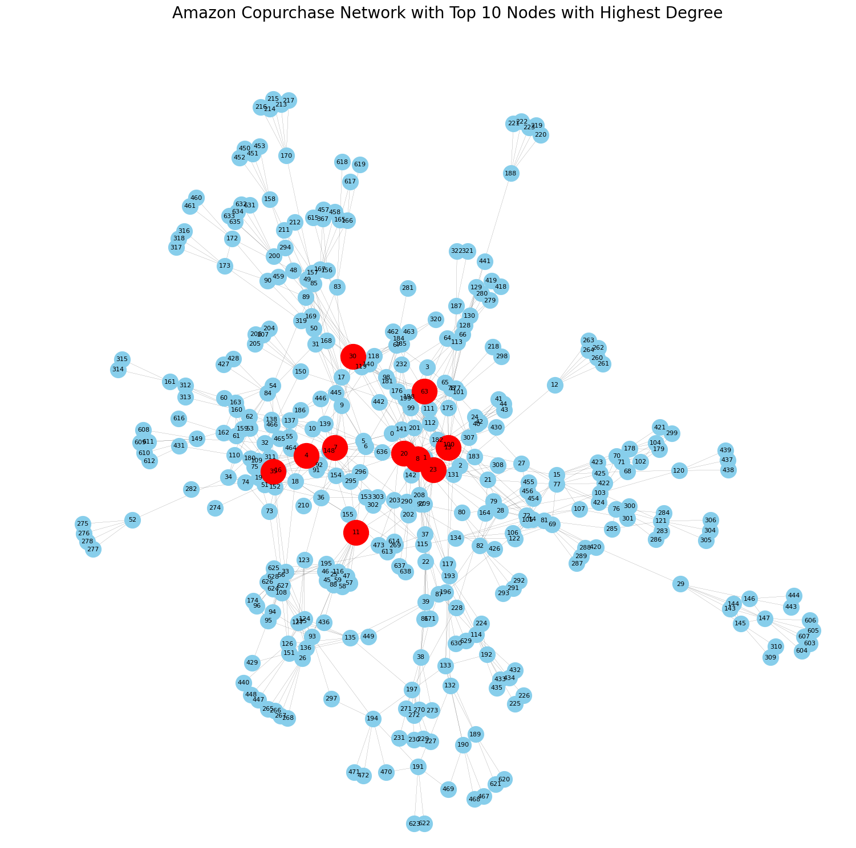
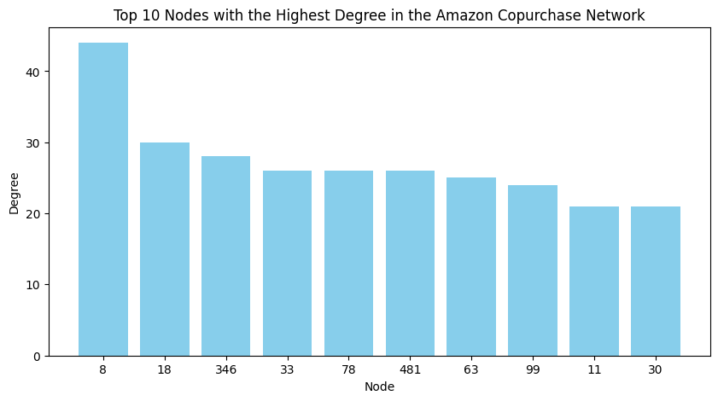
Network Measures: Highest Degree
The node with the highest degree is: 8

Slide 22
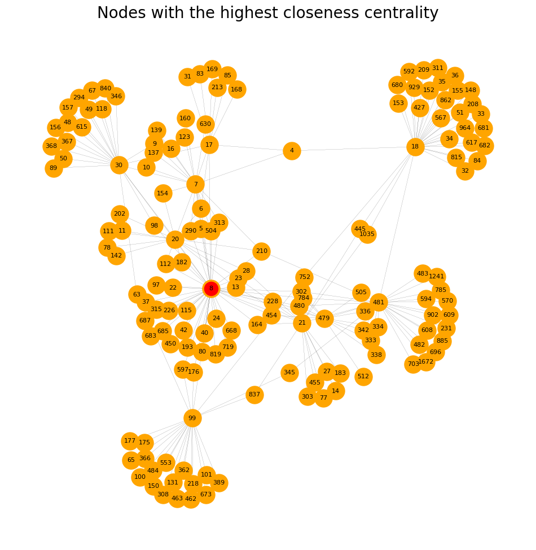
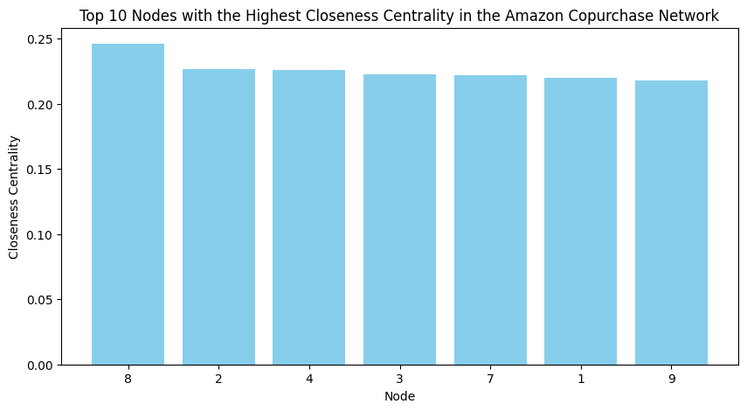
Network Measures: Closeness Centrality
The node with the highest closeness centrality is: 8

Slide 23
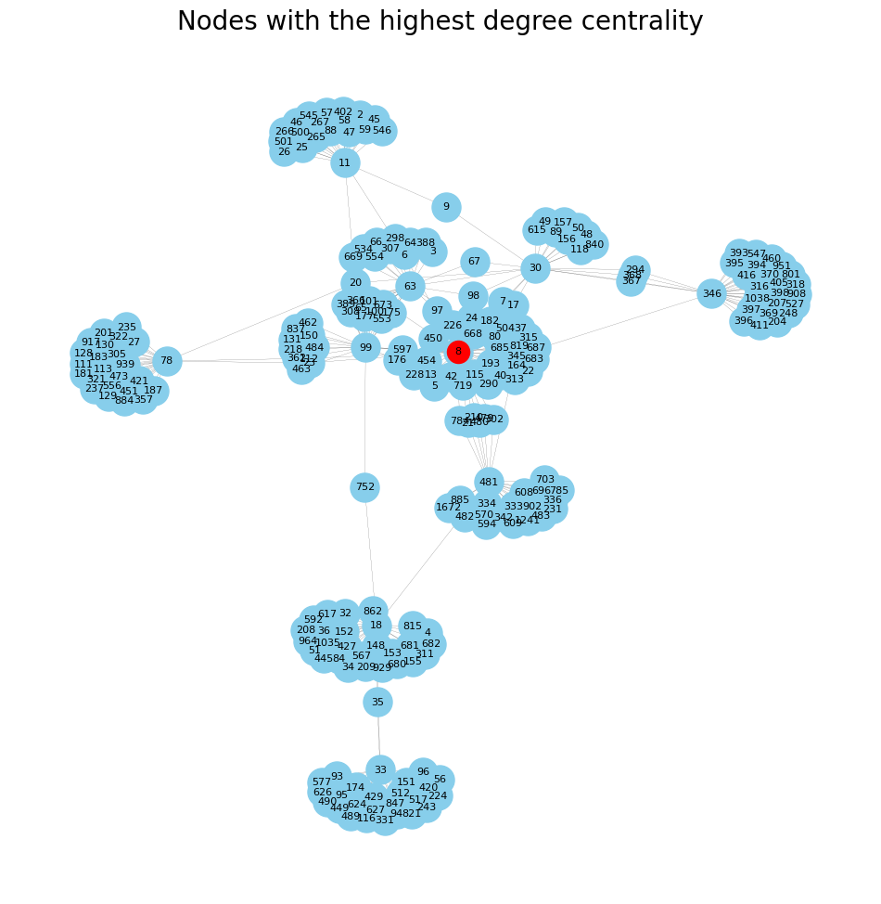
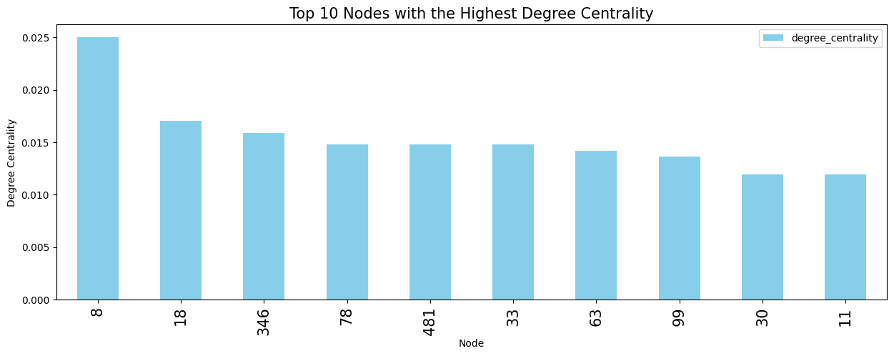
Network Measures: Degree Centrality
The node with the highest degree centrality is: 8

Slide 24
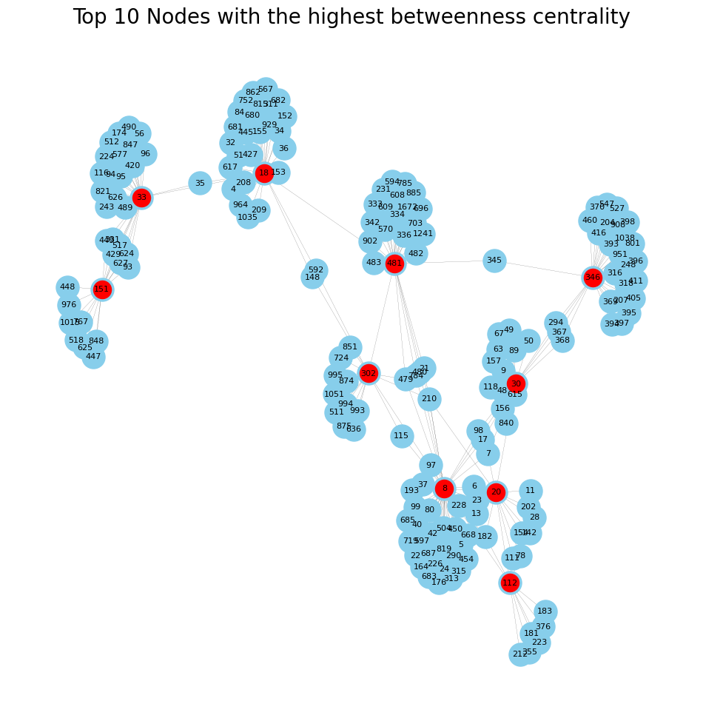
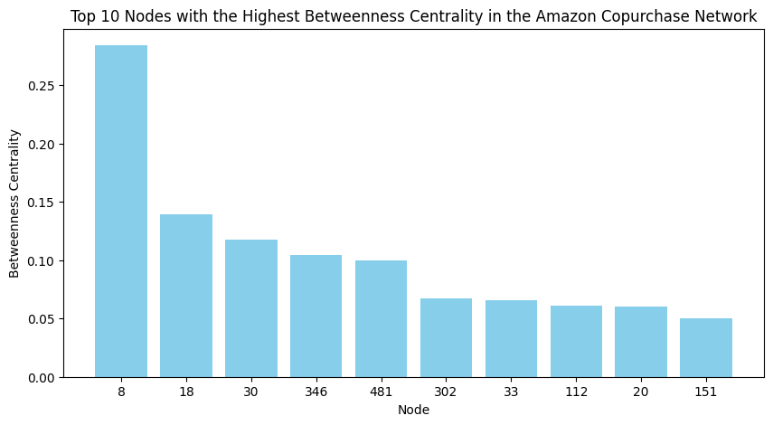
Network Measures: Betweenness Centrality
The node with the highest betweenness centrality is: 8

Slide 25
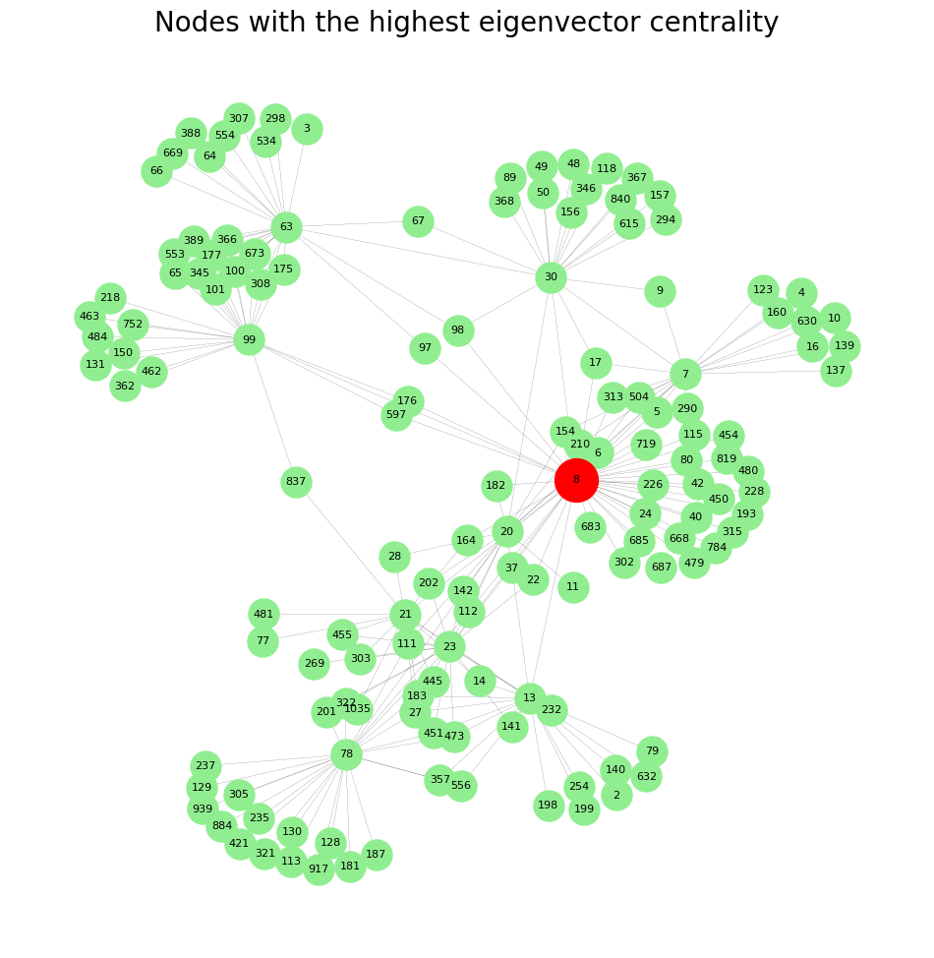
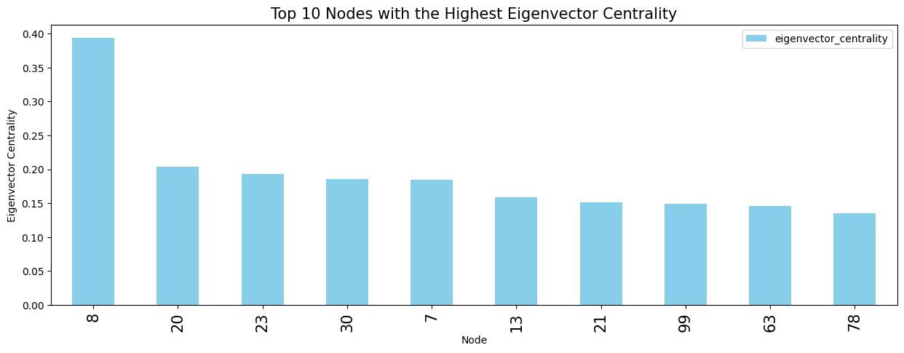
Network Measures: Eigenvector Centrality
The node with the highest Eigenvector centrality is: 8

Slide 26
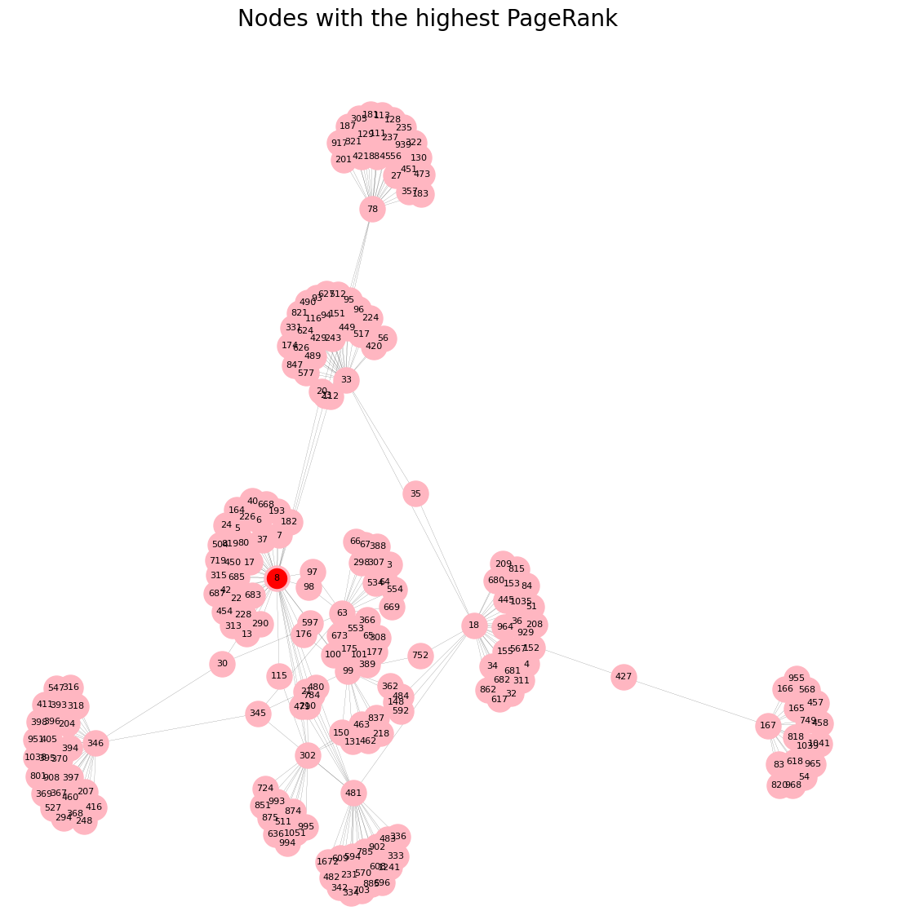
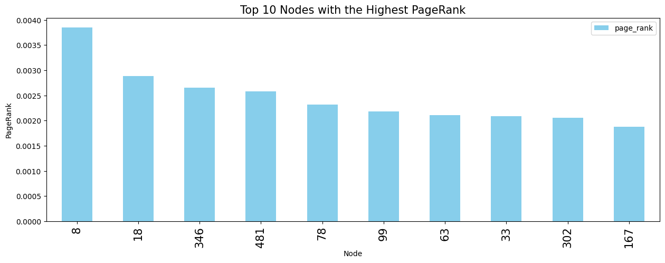
Network Measures: Page Rank
The node with the highest Page rank is: 8

Slide 27
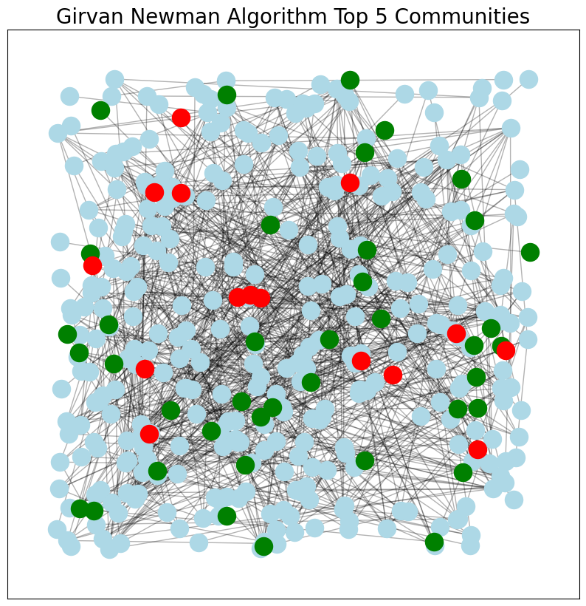
Girvan Newman Communities
The modularity score of Girvan Newman communities is 0.20985850572218268

Slide 28
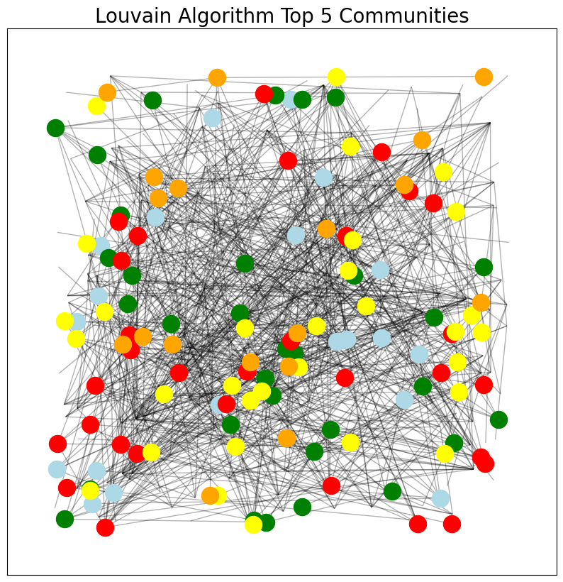
Louvain Communities
The modularity score of Louvain communities is 0.7969436832250805

Slide 29
Machine Learning

Slide 30
Link Prediction

Slide 31
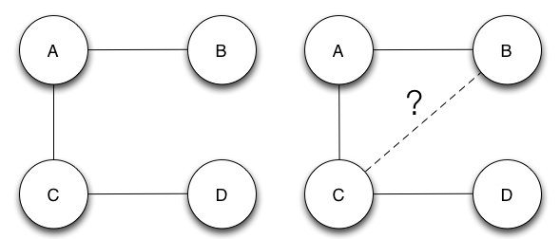
Link Prediction Motivation
Use a network structure to predict the most likely links to form in the Products, Edges: Co-purchasing relationship network.
Predicting future co-purchases between products based on historical data.
Identifying potential connections not present in the current network.
Exploring different similarity measures like common neighbors, Jaccard similarity are used to infer potential connections that can be used to predict links in a network.
Previous works saw prediction improvement when node neighborhood data was combined with node attributes in social networks.

Slide 32
Data Preprocessing
Create the Adjacency Matrix
Finding Missing Edges from the Network
Sample a Part of Connected Edges for Training
Combine Data of Connected and Missing Edges for Training
Generate Graph object using the combined data of positive and negative samples
Generate graph embeddings using Node 2 Vec

Slide 33
Model Development
DataSet
7127 rows of positive and negative samples combined
Test-Train Split
80/20 spilt
Models
Logistic Regression
Decision Tree
Random Forest Classifier
Testing
AUC ROC
Accuracy
SVM

Slide 34
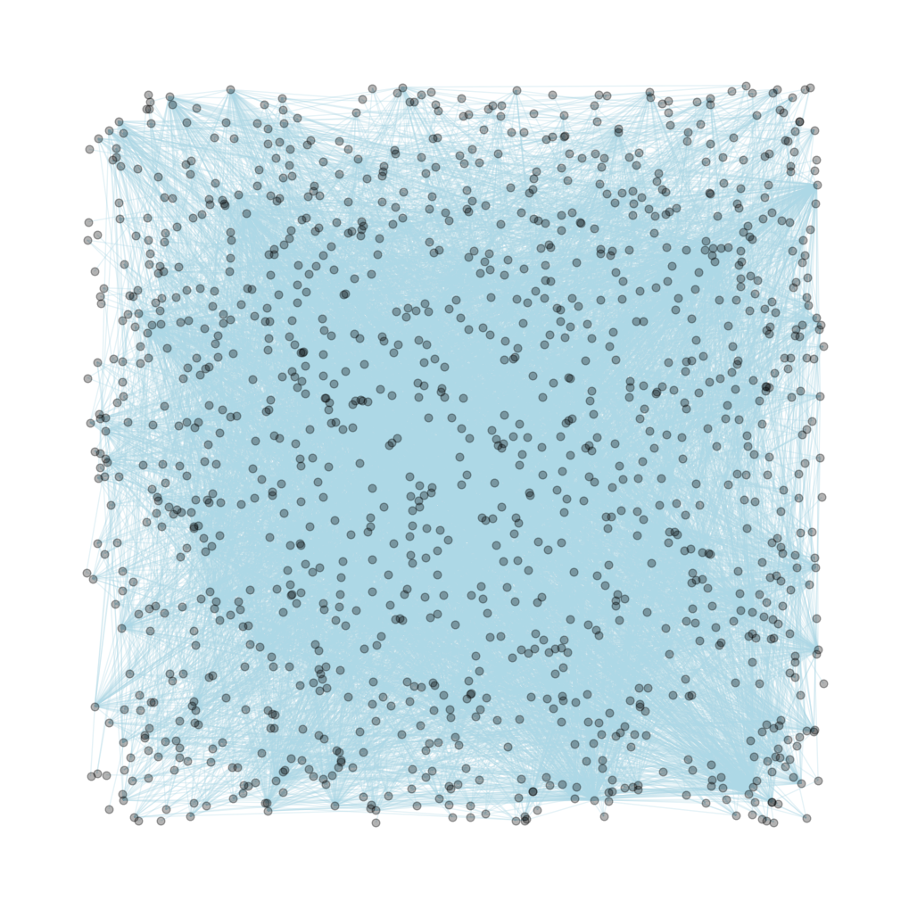
Model fitting
Classification Models
Decision Tree
SVM
Logistic Regression
Random Forest

Slide 35
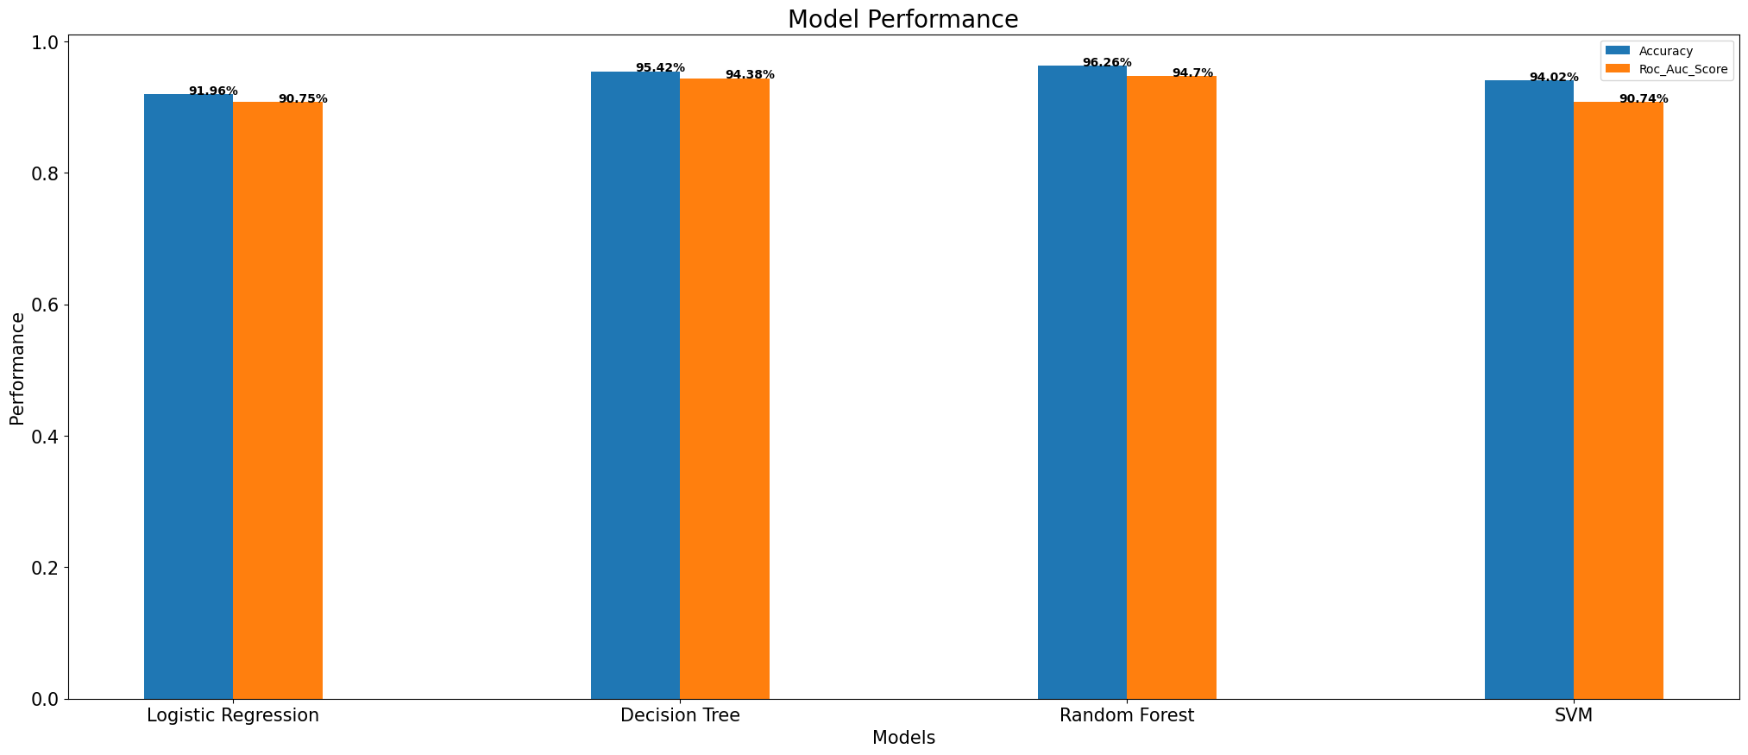
Model Performance
Best Accuracy – Random Forest – 96.26%
Best ROC AUC Score – Random Forest -- 94.7%

Slide 36
Recommendation System

Slide 37
Research Question and Motivation
Analyze Amazon co-purchasing data and create a model to predict the other products co-purchased with a product.
Recommending products based on a user product ASIN Number.
Helps customers find products they may be interested in.
Helps companies increase revenue through targeted recommendations.

Slide 38
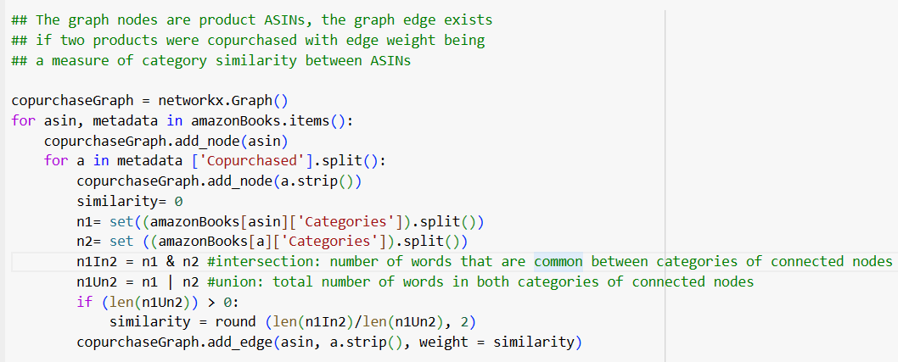
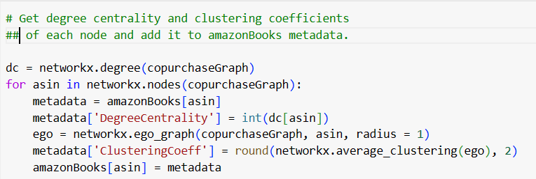
Data Preprocessing
Read the amazon metadata text file and convert it into a products dictionary containing all the categories and data fields.
Filter Amazon products dictionary down to only one Group=Book and write it to amazonBooks dictionary.
Create a Copurchase graph based on Jaccard Similarity of Word similarity of Categories.
Calculate the intersection of total number of words that are common between categories of connected nodes.
Calculate the union of total number of words in both categories of connected nodes.
Calculate the corresponding degree centrality and clustering coefficients of each node and add it to amazonBooks metadata.
Find the nodes having similarity measure based on category above the threshold value and construct a Ego Network.

Slide 39
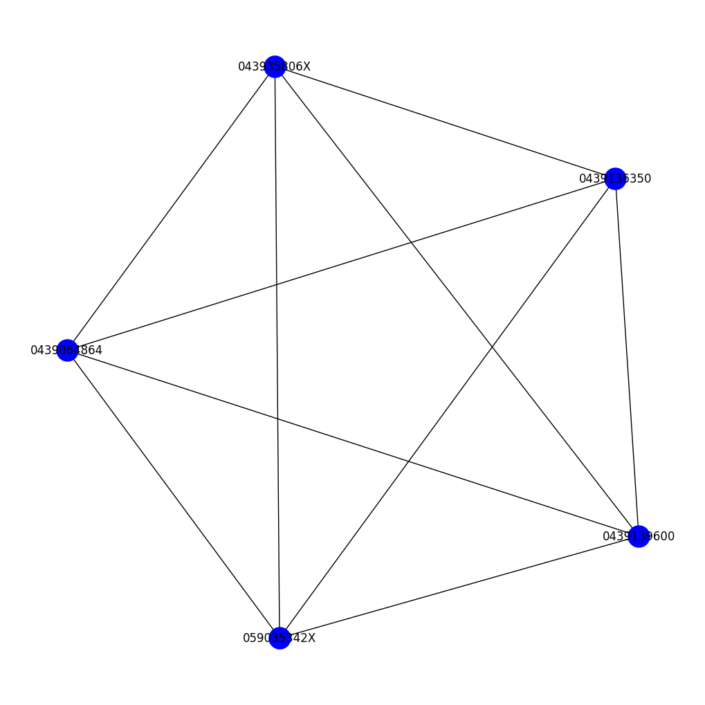
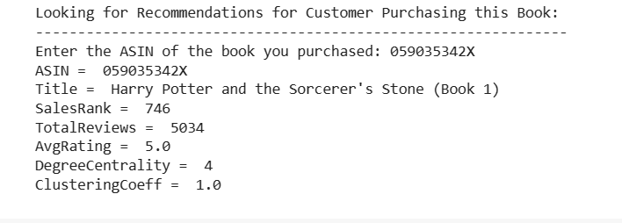
Ego network of the product ASIN
Ego Graph of the Product ASIN 059035342X

Slide 40
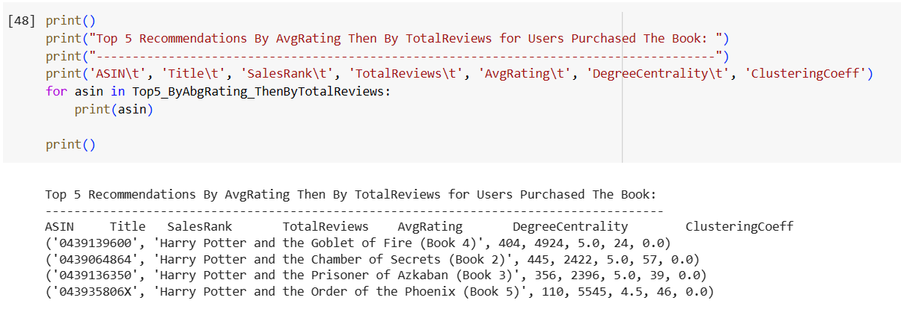
Recommendations

Slide 41
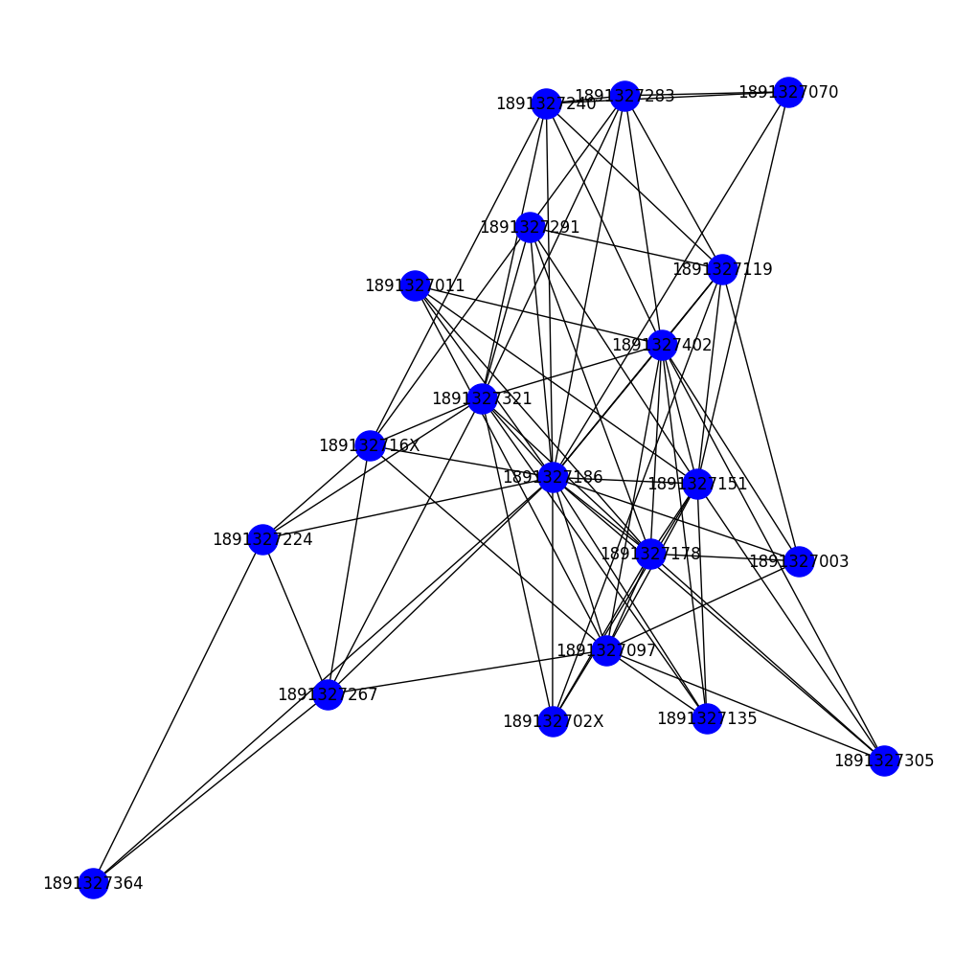
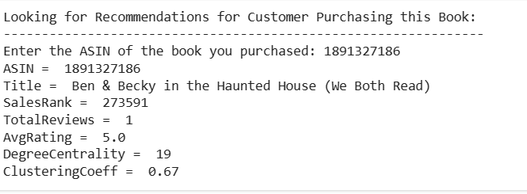
Ego network of the product ASIN
Ego Graph of the Product ASIN 1891327186

Slide 42
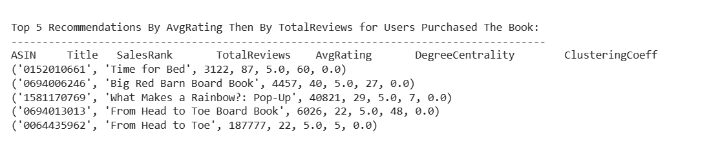
Recommendations

Slide 43
GNN Model

Slide 44
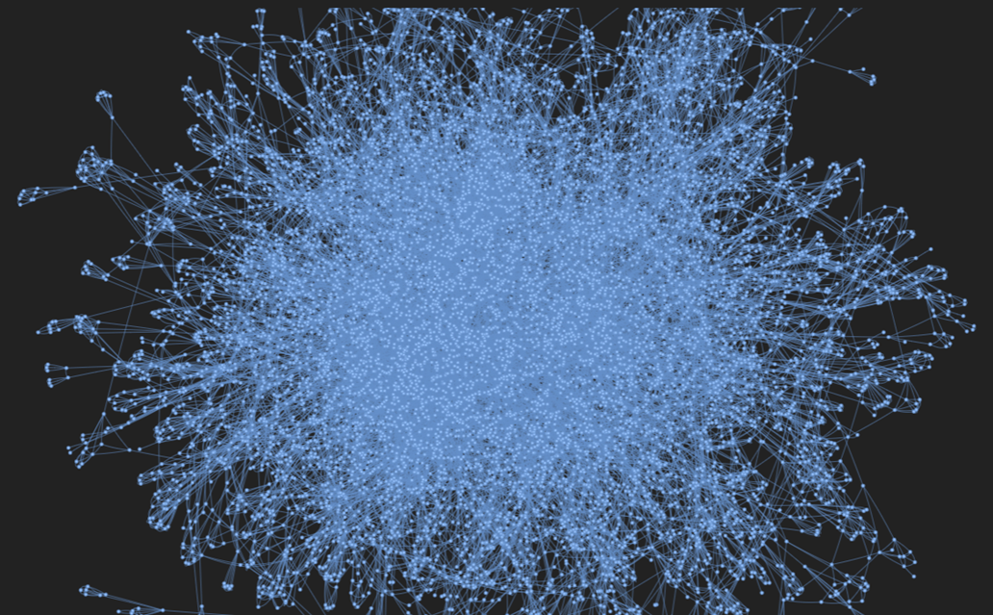
Graph Neural Network
Create 10000 nodes sample set for model
Using RandomLinkSplit to split sample dataset into training (0.9) and validation set (0.1)
Create the equal number of negative links
To predict whether an edge should exist
Notes:
Thao

Slide 45
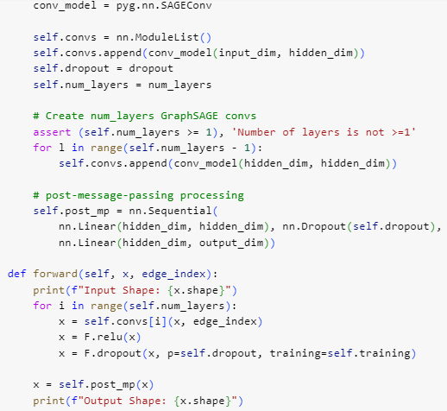
Graph Neural Network
Initialization
GraphSAGE convolutional layers (SAGEConv) for message passing.
Forward Pass (forward method):
The loop iterates over the GraphSAGE convolutional layers:
Applies a GraphSAGE convolution to propagate messages through the graph.
Applies ReLU activation function.
Applies dropout during training for regularization.
After the loop, a post-message-passing processing is applied:
Linear layer with ReLU activation.
Dropout for regularization.
Final linear layer to get the output.
Notes:
Thao

Slide 46
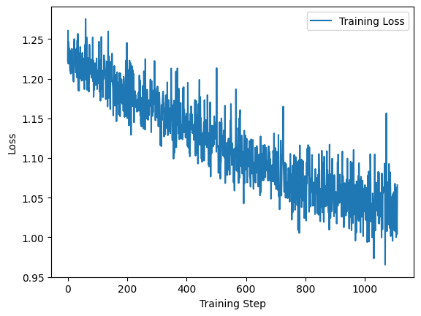
Graph Neural Network
Link prediction:
pairs of node embeddings as input and predict whether an edge should exist
Loss function:
a combination of negative log-likelihood for positive edges and negative log-likelihood for sampled negative edges.
to maximize the likelihood of predicting positive edges correctly while minimizing the likelihood of predicting negative edges incorrectly.
epochs: 30
Notes:
Thao

Slide 47
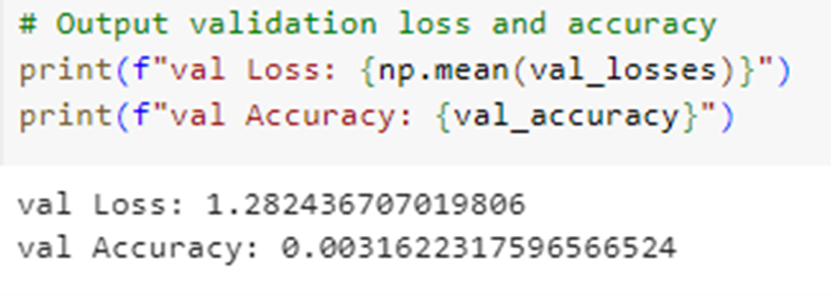
Graph Neural Network
Model performance in validation set
Avg val loss: 1.28
Accuracy is 0.0031
Low accuracy:
The model may not capture the underlying complex patterns in the graph.
The model might need more training epochs to converge.
Notes:
Thao

Slide 48
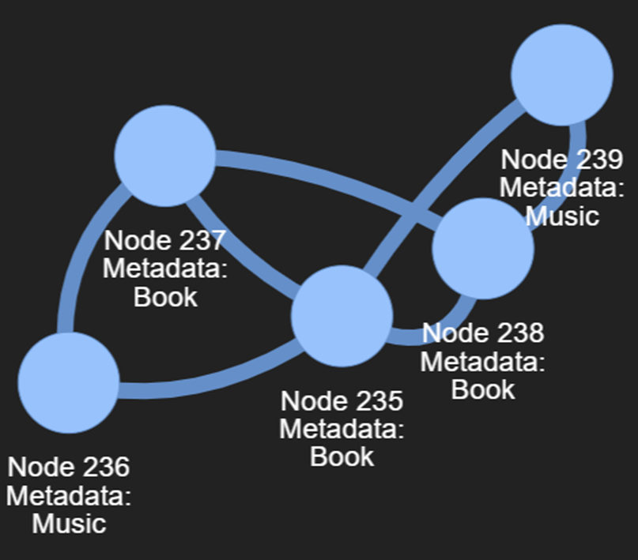
Graph Neural Network
Create a sample from [10000:10500]
Predict the edge
Show the predicted graph with the node group
Notes:
Thao

Slide 49
Conclusion & Next Step
Amazon Metadata EDA: The metadata exploration showed us that Books group is highest purchased but not reviewed, whereas the DVDs and Music groups are highest reviewed items but not purchased.
Amazon0302 Network EDA Data exploration: Node 8 stood out as the node with Highest degree, Degree Centrality, Closeness Centrality, Betweenness Centrality, Eigenvector Centrality and Page rank centrality. The Louvain method of community detection proved to be superior community detection method with a higher modularity score as compared to the Girvan Newman community detection method.
Link Prediction: The Random Forest algorithm provided the best Accuracy score and ROC AUC score for link prediction within the network.
Recommendation System: Our Recommendation system has provided a Novel model to predict the recommended items for any given product ASIN number based on Jaccard Similarity of words in Categories which helps customers to purchase next item and helps the company to understand purchasing patterns and increase revenue.
GNN----demonstrates the training and prediction process on a subgraph of the original graph data. The model is trained to capture meaningful node embeddings, and link prediction is performed on selected node pairs.
Next step----extending the model architecture to capture more complex pattern; training model with a higher number of epochs to improve its learning capacity.
Notes:
Thao

Slide 50
Contribution
Qiuyuan Zhang
Amazon Metadata EDA
Shreyashi Mukhopadhyay: ​
Amazon 0302 Network EDA​
Link Prediction ​
Recommendation System​
​
Xiaohong Liu:​
Graph Neural Network
Notes:
Thao

Slide 51

Questions?

Slide 52
Thank you!

